Slide 1
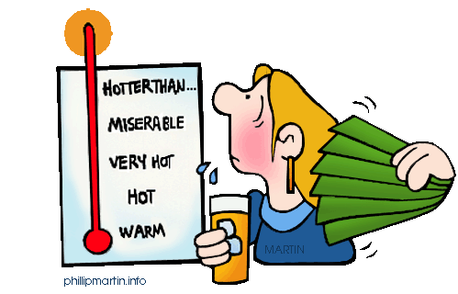
Chapter 15 Temperature, Heat & Expansion

Slide 2
Objectives
What is ‘temperature’?
What is ‘heat’?
Specific Heat Capacity of a substance
Thermal Expansion
Thermal Expansion of Water

Slide 3
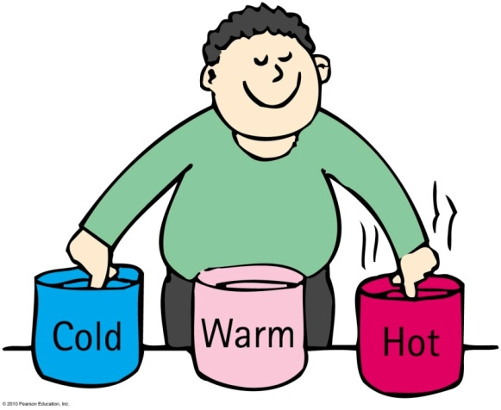
What is Temperature?

Slide 4
What is Temperature?
The quantity that indicates warmth of a substance with respect to some standard is called temperature.

Slide 5
Atoms and molecules in matter have kinetic energy due to random motion (linear, rotational, vibrational)
The average translational KE produces warmth.

Slide 6
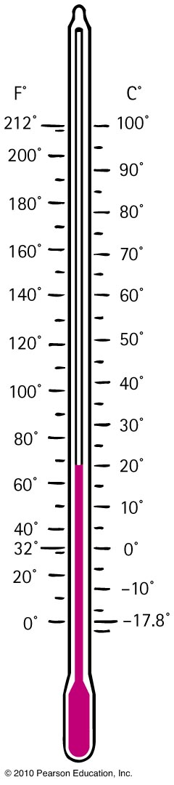
Temperature
Temperature is measured by a thermometer.
Measures temperature by expansion or contraction of a liquid (mercury or colored alcohol)
Reading occurs when the thermometer and
the object reach thermal equilibrium
(having the same average kinetic energy per particle)

Slide 7
Temperature Scales
Celsius scale named after Anders Celsius
0°C for freezing point of water to 100°C for boiling point of water
Fahrenheit scale named after G. D. Fahrenheit
32°F for freezing point of water to 212°F for boiling point of water
Kelvin scale named after Lord Kelvin
273 K for freezing point of water to 373 K for boiling point of water
0 K = absolute zero ( -273⁰C)
At 0 K, substance has no kinetic energy.

Slide 8
Conversion
Celsius to Fahrenheit
(°C × ⁹/₅) + 32 = °F
Fahrenheit to Celsius
(°F - 32) x ⁵/₉ = °C
Celsius to Kelvin
(°C + 273) = K

Slide 9
To say that body A has a higher temperature than body B is to say that body A has more
A. internal energy.
mass.
kinetic energy per particle.
potential energy.

Slide 10
To say that body A has a higher temperature than body B is to say that body A has more
A. internal energy.
mass.
kinetic energy per particle.
potential energy.

Slide 11
Heat (Q)
Heat is NOT temperature.
Heat is Internal energy transferred from one thing to another due to a temperature difference.
It is internal energy in transit. (Once transferred, the energy ceases to be heat)

Slide 12
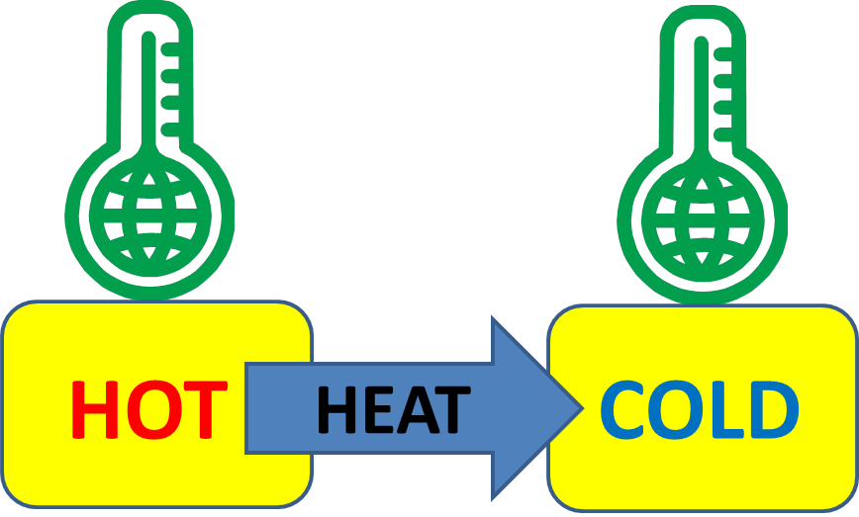
Heat flows from a high-temperature substance to a low-temperature substance until thermal equilibrium is reached.
How much heat flows will depend both on the temp. difference and on the amount of material.

Slide 13
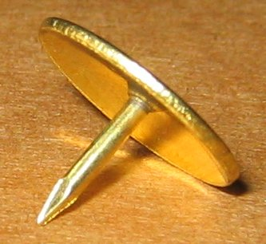
If a red-hot thumbtack is immersed in warm water, the direction of heat flow will be from the
A. warm water to the red-hot thumbtack.
red-hot thumbtack to the warm water.
There will be no heat flow.
Not enough information.

Slide 14
If a red-hot thumbtack is immersed in warm water, the direction of heat flow will be from the
A. warm water to the red-hot thumbtack.
red-hot thumbtack to the warm water.
There will be no heat flow.
Not enough information.

Slide 15
Quantity of Heat
Heat is internal energy in transit.
So, what is the unit of heat?

Slide 16
Quantity of Heat
Heat is measured in joules or calories
4.18 joules = 1 calorie
4.18 joules of heat are required to change the temperature of 1 gram of water by 1 Celsius degree
More water → more heat needed to change the temperature

Slide 17
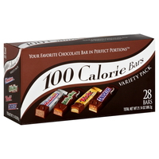
Heat unit for labeling food
Energy ratings of foods and fuels are determined from energy released when they are burned.
Calorie, is the common unit for food. (with a capital C)
1 Calorie = 1 kilocalorie or 1000 calories

Slide 18
The same quantity of heat is added to different amounts of water in two equal-size containers. The temperature of the smaller amount of water
A. decreases more.
increases more.
does not change.
Not enough information.

Slide 19
The same quantity of heat is added to different amounts of water in two equal-size containers. The temperature of the smaller amount of water
A. decreases more.
increases more.
does not change.
Not enough information.

Slide 20
You heat a half-cup of tea and its temperature rises by 4°C. How much will the temperature rise if you add the same amount of heat to a full cup of tea?
A. 0°C
2°C
4°C
8°C

Slide 21
You heat a half-cup of tea and its temperature rises by 4°C. How much will the temperature rise if you add the same amount of heat to a full cup of tea?
A. 0°C
2°C
4°C
8°C

Slide 22
Specific Heat Capacity (c)
Defined as the quantity of heat required to change the temperature of a unit mass of the substance by 1 degree Celsius.
Like thermal inertia, c is the resistance of a substance to a change in temperature.
Higher c → harder to change the temperature

Slide 23
Different substances have different thermal capacities for storing energy.
Example:
Takes about 2 minutes to raise the temperature of an iron pot of water to boiling temperature.
Takes less than 1 minute to raise the temperature of the same quantity of water in a silver pot to boiling temperature.
Which one has higher specific heat capacity? Iron pot or silver pot?

Slide 24
Specific Heat Capacity
Water = 4186 J/kg ⁰C
Iron = 448 J/kg ⁰C
Silver = 234 J/kg ⁰C
Glass = 837 J/kg ⁰C
Copper = 387 J/kg ⁰C

Slide 25
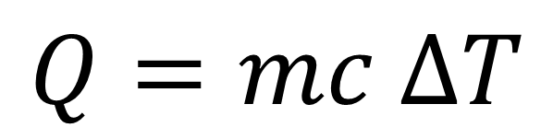
Specific Heat Capacity
Energy Q needed to raise the temperature of
a system of mass m by ΔT :
$$Q=mc ∆T$$

Slide 26

Example:
How much energy is required to raise the temperature of 0.5 kg of water by 3.0 ⁰C ?
C_{water} = 4186 J/kg ⁰C
$$Q=mc ∆T$$
Q = (0.5 kg) (4186 J/kg ⁰C) (3.0 ⁰C )
= 6.28 x 10³ J

Slide 27
Equal masses of different materials required different quantities of heat to change their temperatures by a specified number of degrees.
1 gram of water requires 1 calorie of energy to raise the temperature 1 degree Celsius.
1 gram of iron requires 1/8 as much energy for the same temperature increase.
Therefore, water absorbs more heat than iron for the same change in temperature. Water has a higher specific heat .

Slide 28
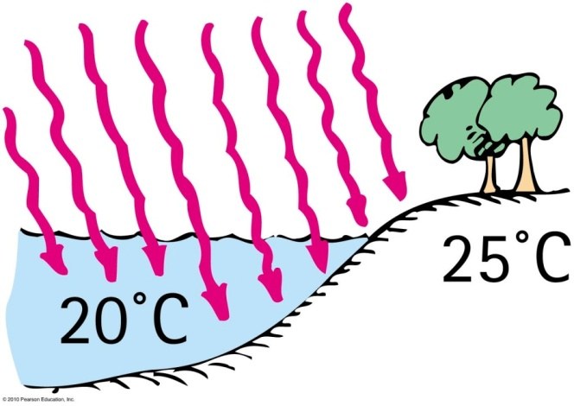
Which has the higher specific heat capacity, water or land?
A. Water
Land
Both of the above are the same.
None of the above.
Hint: which one needs a longer time to heat up?

Slide 29
Which has the higher specific heat capacity, water or land?
A. Water
Land
Both of the above are the same.
None of the above.
Hint: which one needs a longer time to heat up?

Slide 30
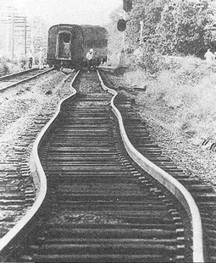
Thermal Expansion
Due to rise in temperature of a substance, molecules jiggle faster and move farther apart.
Most substances expand when heated and contract when cooled.

Slide 31
Thermal Expansion
Examples:
Warming metal lids on glass jars under hot water loosens the lid by more expansion of the lid than the jar.
Use of reinforcing steel with the same rate of expansion as concrete—expansion joints on bridges.
Gaps on concrete roadways and sidewalks allow for concrete expansion in the summer and contraction in the winter.

Slide 32
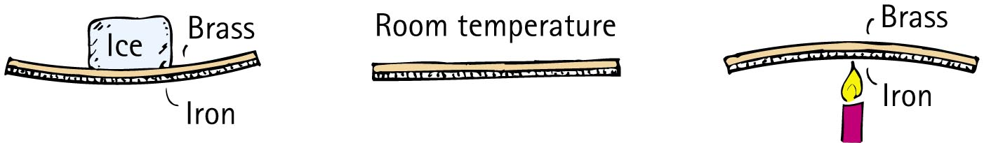
Thermal Expansion
Different substances expand at different rates.
Example:
When the temperature of a bimetallic strip of brass and iron is increased, greater expansion occurs for the brass strip, which bends to turn a pointer, to regulate a valve, or to close a switch.
Bimetallic strips are used in heaters, oven thermometers, refrigerators, and electric toasters.

Slide 33
When stringing telephone lines between poles in the summer, it is advisable to allow the lines to
A. sag.
be taut.
be close to the ground.
allow ample space for birds.

Slide 34
When stringing telephone lines between poles in the summer, it is advisable to allow the lines to
A. sag.
be taut.
be close to the ground.
allow ample space for birds.
Explanation:
Telephone lines are longer in a warmer summer and shorter in a cold winter. Hence, they sag more on hot summer days than in winter. If the lines are not strung with enough sag in summer, they might contract too much and snap during the winter—especially when carrying ice.

Slide 35
Thermal Expansion
Increases in expansion are greater in liquids than in solids.
Example:
Overflow of gasoline from a car’s tank on a hot day.
Reason: Gasoline underground is cool, but when placed in the car’s tank, it warms and expands.

Slide 36
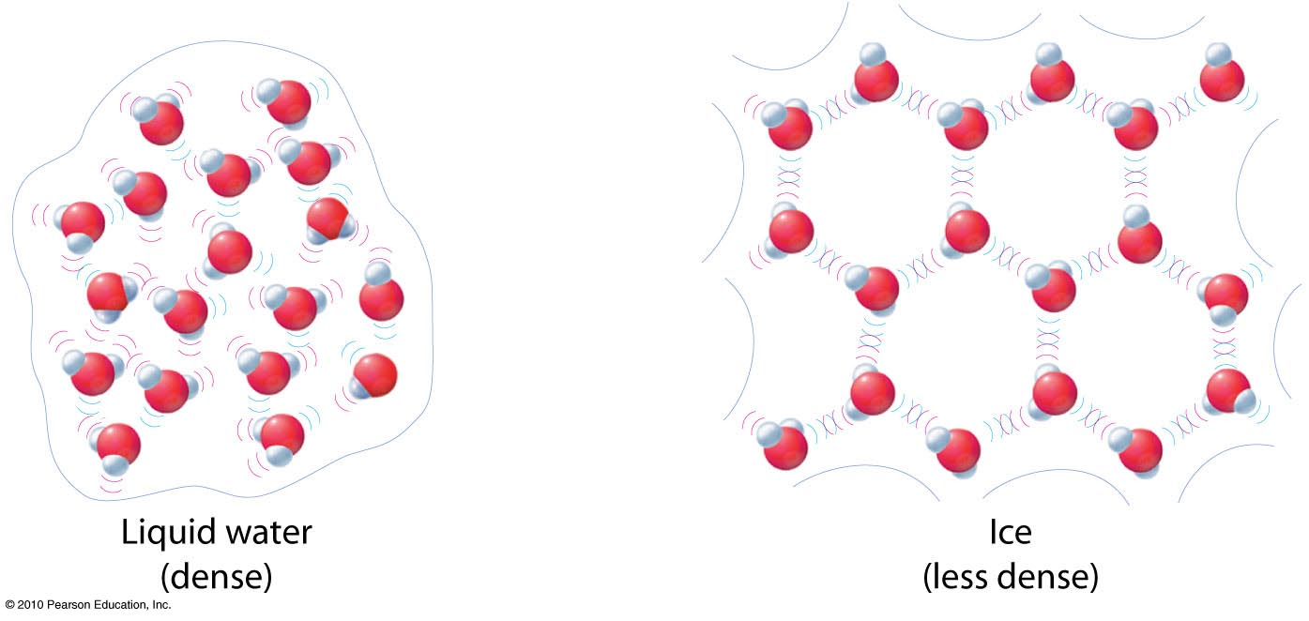
Thermal Expansion of Water
Water, like most other substances, expands when heated.
But, it doesn’t expand in the temperature range between 0ºc and 4 ºC.

Slide 37
Thermal Expansion of Water
When ice freezes to become solid ice, its volume increases tremendously. As solid ice cools further, it contracts. Density of ice at any temperature is much lower than the density of water, which is why ice floats on water.

Slide 38
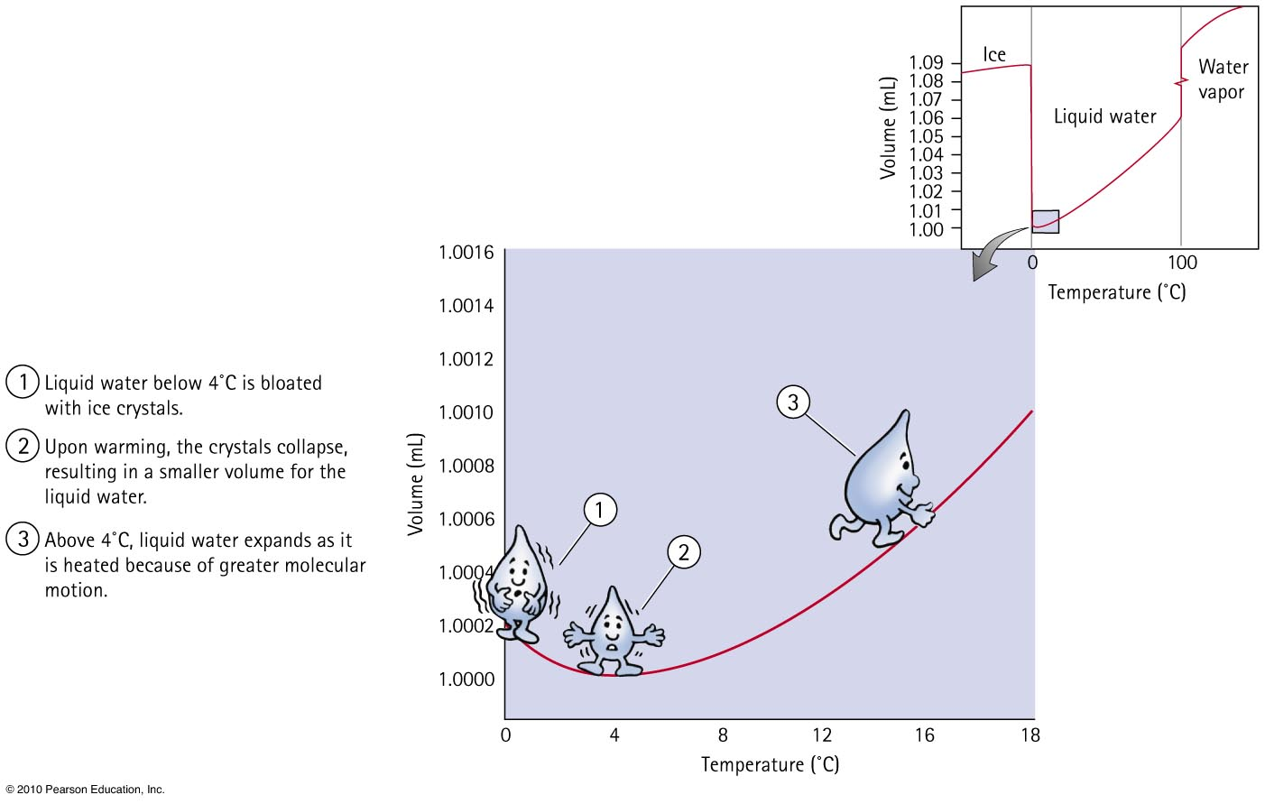
Thermal Expansion of Water

Slide 39
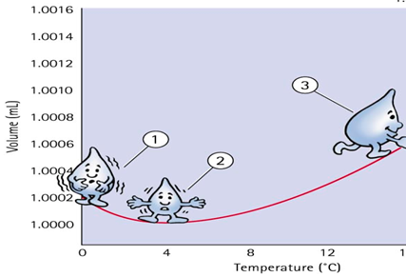
When a sample of 0°C water is heated, it first
A. expands.
contracts.
remains unchanged.
Not enough information.

Slide 40
When a sample of 0°C water is heated, it first
A. expands.
contracts.
remains unchanged.
Not enough information.
Explanation:
Water continues to contract until it reaches a temperature of 4°C. With further increase in temperature beyond 4°C, water then expands.

Slide 41
When a sample of 4°C water is cooled, it
A. expands.
contracts.
remains unchanged.
Not enough information.

Slide 42
When a sample of 4°C water is cooled, it
A. expands.
contracts.
remains unchanged.
Not enough information.
Explanation:
Parts of the water will crystallize and occupy more space.

Slide 43
Homework
Read Chapter 15 in detail.
Do Exercises 2, 5, 7, 42, 45
Homework due : July 02

